Slide 1
Private & Retail Segment
Summary document
June 2026

Slide 2
Contents
Private banking
Retail banking

Slide 3










Private banking leaders are shifting from broad premium service to selective wealth franchises
Anchors of success
Description of success
Best case examples
Game Changers
1
Segmentation and eligibility discipline with tiered bundles
Affluent, HNW and UNW segments are defined by assets, income, profitability, potential and service needs, with differentiated product, RM and privilege bundles
2
Advisory-led relationship model
RM coverage shifts to structured advisory: portfolio reviews, investment narratives, family wealth planning, cross-border needs assessment, and access to specialists when needed
3
Private client club and exclusive community
Private banks create loyalty through invitation-only investment briefings, closed CEO / entrepreneur dinners, culture events and premium travel privileges
Incumbent moves
4
Family and entrepreneur wealth advisory
Business owners and private families receive structured support on succession, inheritance, family governance, and next-generation preparation
5
Future-private acquisition
High-potential entrepreneurs, senior executives, heirs and affluent clients are identified early, invited into selected events and given a limited premium bundle
6
Invitation-led prospecting events
Closed events around investments, entrepreneurship, family business, education abroad, real estate or succession are used to engage high-potential prospects
Enablers
7
PB-specific wealth product suite
Private Banking product suites include access to international bonds, funds, structured products, multi-currency wealth accounts, consolidated portfolio reporting and preferential pricing
8
Private banking service model readiness
RMs are equipped with certification, product playbooks, family-advisory scripts, pre-call briefing packs and next-best-action prompts
9
Premium experience partnership network
Partnerships with travel, hospitality, education, healthcare, culture, luxury retail and business communities provide exclusive privileges the bank cannot credibly build alone

Slide 4









Defining “private banking customers” is critical to understand addressable market size
Pros
Regionally observed entry criteria models
Cons
Entry criteria category
Threshold USD
GDP adjusted threshold USD¹
Description
Peer-bank examples
Key implications for PASHA Bank
1. AUM threshold
Client qualifies based on investable assets or by providing high a high income trajectory
  Simple, transparent to enforce
  Easy to verify
  Misses illiquid entrepreneurs
  Excludes future HNWIs
TBC Bank
AUM
250K
227K
  PASHA Bank should use AUM as primary qualification metric, based on selective exception criteria to capture high-potential clients beyond current investable assets
  AUM threshold of ~250K USD appears appropriate for PASHA Bank, aligning with regional peer benchmarks
Garanti BBVA
AUM
400K
240K
Yapı Kredi
AUM
600K
350K
2. Total Relationship Value
Client qualifies based on the total economic value of the relationship
  Captures full relationship
  Rewards loyal borrowers
  Overstates investable wealth
  Complex to administer
Emirates NBD
Total Relationship Value
5M
720K
QNB
Total Relationship Value
5.5M
500K
SNB
Total Relationship Value
3M
750K
3. Annual Income
Client qualifies based on annual income or earning capacity
  Captures future potential
  Builds loyalty early
  Income inherently volatile
  Requires ongoing recertification
FirstRand
Annual income
41K
52K
Investec
Annual income
43K
55K
Standard Bank
Annual income
60K
76K
¹ Thresholds adjusted to Azerbaijan GDP per capita to enable fair cross-market comparison
Source: Company website, Press search, Expert input

Slide 5
Azerbaijan private banking market size is expected to be ~6.2k individuals based on bottom-up census approach
A. Bottom-up approach highlights ~6.2k eligible individuals across key wealth-holder segments
Approach Name
Description
A
  Enumerates identifiable wealth-holders
  Includes enterprise owners and senior professionals
  Adjusts for shadow economy
# individuals
Component
Estimation base
Large Enterprise Owners
Component | # individuals | Estimation base
Large Enterprise Owners | 804 | Count of large enterprises, adjusted for domestic-private share and multiple principals
Upper-Medium Enterprise Owners | 895 | Count of medium enterprises in the upper quadrant of the AZN 3-30M band, adjusted for domestic-private share and multiple principals
Oil & Gas Salaried Professionals | 3,500 | Senior salaried oil & gas professionals (SOCAR, BP, other IOCs) above the income/wealth bar
Non-Oil Professional HNWIs | 605 | High-net-worth non-oil professionals across international orgs, government, law, real estate and tech
Shadow Economy Adjustment | 900 | Informally-held wealth not captured in registries, sized to the shadow economy
Gross addressable (sum) | 6,704 | Sum of all qualifying segments before removing double-counting
Less: systematic overlaps | 500 | Individuals appearing in more than one segment, deducted to count once
Net eligible | 6,204 | Net unique private-banking-eligible individuals after overlap adjustment
Bottom-Up
Calculation
804
Count of large enterprises, adjusted for domestic-private share and multiple principals
Upper-Medium Enterprise Owners
895
Count of medium enterprises in the upper quadrant of the AZN 3-30M band, adjusted for domestic-private share and multiple principals
B
  Narrows wealth distribution to bankable assets
  Focuses on liquid and investable holdings
Oil & Gas Salaried Professionals
3,500
Senior salaried oil & gas professionals (SOCAR, BP, other IOCs) above the income/wealth bar
Investable
Wealth Lens
Non-Oil Professional HNWIs
605
High-net-worth non-oil professionals across international orgs, government, law, real estate and tech
Shadow Economy Adjustment
900
Informally-held wealth not captured in registries, sized to the shadow economy
C
  Uses total net worth distribution
  Includes real estate and illiquid assets
  Broadest measure of market potential
Gross addressable
6,704
Sum of all qualifying segments before removing double-counting
Total Wealth Lens
Systematic overlaps
(500)
Individuals appearing in more than one segment, deducted to count once
Net eligible
6,204
Net unique private-banking-eligible individuals after overlap adjustment
Internal analysis

Slide 6
Leveraging existing CIB relationships, PB can increase its private banking share to 30% by 2029
A. Current PB segments can be refined by raising thresholds and migrating below-threshold clients into affluent retail
B. PBA can pursue ~1250 fair-share clients in private banking
Key Insights
Retail
Private
# customers in deposit bands
Market
PBA
A
~85% of current Private Banking income comes from Heritage clients, so serving mass affluent and affluent clients under PB is not economically necessary
Current segment
Proposed segment
Minimum deposit, USD
Criteria
NBI market potential
Uplift potential
Origin
  100k AZN deposit or
  100k USD investment
Mass affluent
39 M AZN
51 M AZN
10K – 100K
Includes 23 private banking customers of PASHA Capital
# additional customers to capture fair share
B
Redefining the segments within private banking will reduce pressure on PB RMs and allow higher-touch coverage for early-PB, HNWI and UHNWI through deeper advisory, better product access and more exclusive service
531
Affluent
100K – 250K
~6800
Horizon
  300k AZN deposit or
  300k AZN investment
~6200
75%
~1240
Origin
250K – 500K
339
93%
# additional NBI potential, AZN M
Horizon
A
Heritage
  1M AZN deposit or
  1M AZN investment
500K - 1Mn
25%²
6
Heritage
7-8%¹
187
1Mn+
2025
2029 (projection)
¹ 460 current customers in the 250K+ USD band, based on existing segment distribution and additional uncaptured PASHA Capital clients
² Fair-share opportunity is based on PBA’s CIB market share, implying a target of ~30% penetration of the addressable market

Slide 7




Banks focus on enriching product offer and developing complementary services for private banking customers…
Parent category
Detailed product / service
Key Insights
Core banking
Premium current accounts / everyday banking
  PASHA Bank already covers most core private banking needs, with a broad product suite - though several propositions are delivered indirectly through partner capabilities:
    Wealth management is executed through PASHA Capital, since it has brokerage license
  Next differentiation opportunity lies in:
    Improving the digital app journey
    Reducing manual wealth-management processes with PASHA Capital and establishing guardrails regarding customer types
    Shifting lifestyle benefits toward exclusive community-led privileges
Deposits / term deposits
Multi-currency accounts / FX
—
Digital / mobile banking for affluent clients
Cards & payments
Miles / travel card proposition
—
Cashback / rewards
—
Preferential transfers or cash withdrawal
Credit & liquidity
Deposit-backed / cash-covered lending
—
—
—
Mortgage / real estate finance
—
Investments & wealth
Investment advisory / financial planning
Portfolio management
Structured products
—
—
Brokerage / securities trading
Gold / precious metals / metal accounts
—
Protection & planning
Insurance / travel insurance
Tax advisory
—
—
Legal / estate / inheritance planning
—
—
—
Lifestyle & privileges
Safe deposit boxes
Airport lounge access
Fast track / airport transfer / meet & assist
Events / art / culture / exclusive gatherings
—
Medical check-up / wellness perks
—
—
—
—
Family / entrepreneur
Education advisory
—
—
—
—
Source: Company website, Press search, Expert input

Slide 8









… Banks also differentiate themselves with beyond-banking unique offers to make private customers feel privileged and part of the club
Unique offers
Basic offers
Travel
Free luxury hotel night for new customers; special offers in hotels
Travel, Luggage
FastTrack cost compensation at airport
Free Wi-Fi/roaming worldwide
Access to own lounges at airports
Priority Pass/Lounge Key
Business and leisure travel itinerary management
Entertain-ment
Free unlimited golf lessons; and access to special golf courses
Free access to exclusive places of interest in England: museums, galleries
Access to the Insignia yacht in the prestigious ONE°15 yacht club (Singapore)
Priority reservations at Michelin restaurants around the world
Family and health
Full range of medical services, including vaccinations, psychologists and dentists
Programs for children (from financial and ethical education to entertainment programs)
Assistance with selecting a school for a child
Source: Company website, Press search

Slide 9
Strategic lever summary – Become local Private Banking benchmark in products and service
IMPACT ESTIMATION TO BE VERIFIED WITH BOTTOM-UP MODEL
PASHA Bank vision
Roadblocks
Initiatives
Expected Impact by 2029
Build PBA into the local Private Banking benchmark by focusing on true USD 250K+ private clients, delivering high-touch advisory and distinctive wealth solutions, and creating an exclusive community that signals status and attracts future private clients
Service model does not enable personal touch due to too many clients per PB coverage model, limiting advisory depth and proactive relationship management
  Segmentation reset and PB perimeter clean-up to narrow down focus on truly wealthy individuals and ensure high-touch coverage:
    Define PB eligibility at USD 250K+ AUM
    Migrate sub-USD 250K clients to Retail/Affluent coverage with clear upgrade triggers into PB
6
  Net banking income impact primarily from fee income, AZN MN
Perks and benefits do not yet signal exclusive Private Banking status, with limited closed community, invitation-only events and premium partner privileges
  Differentiate clients PB-eligible clients between PBA and PASHA Capital, with former focusing only on individuals, and latter one on corporate investors, subject to brokerage license constraint
  Luxury lifestyle and privilege partner network to strengthen “status signaling” and differentiate the proposition
    Build curated partnerships across travel, hospitality, healthcare, education, culture, luxury retail and concierge (e.g., premium travel access, private healthcare packages, education support and lifestyle privileges)
Future-private acquisition is not systematic – high-potential entrepreneurs, C-suite executives, heirs and affluent clients are not yet consistently identified, nurtured through events, or converted into PB through a structured incubator / prospecting model
  Private Client Club and events to build exclusive community, reinforce status and capture future private clients through closed investment briefings, CEO dinners and family business forums

Slide 10
Contents
Private banking
Retail banking

Slide 11


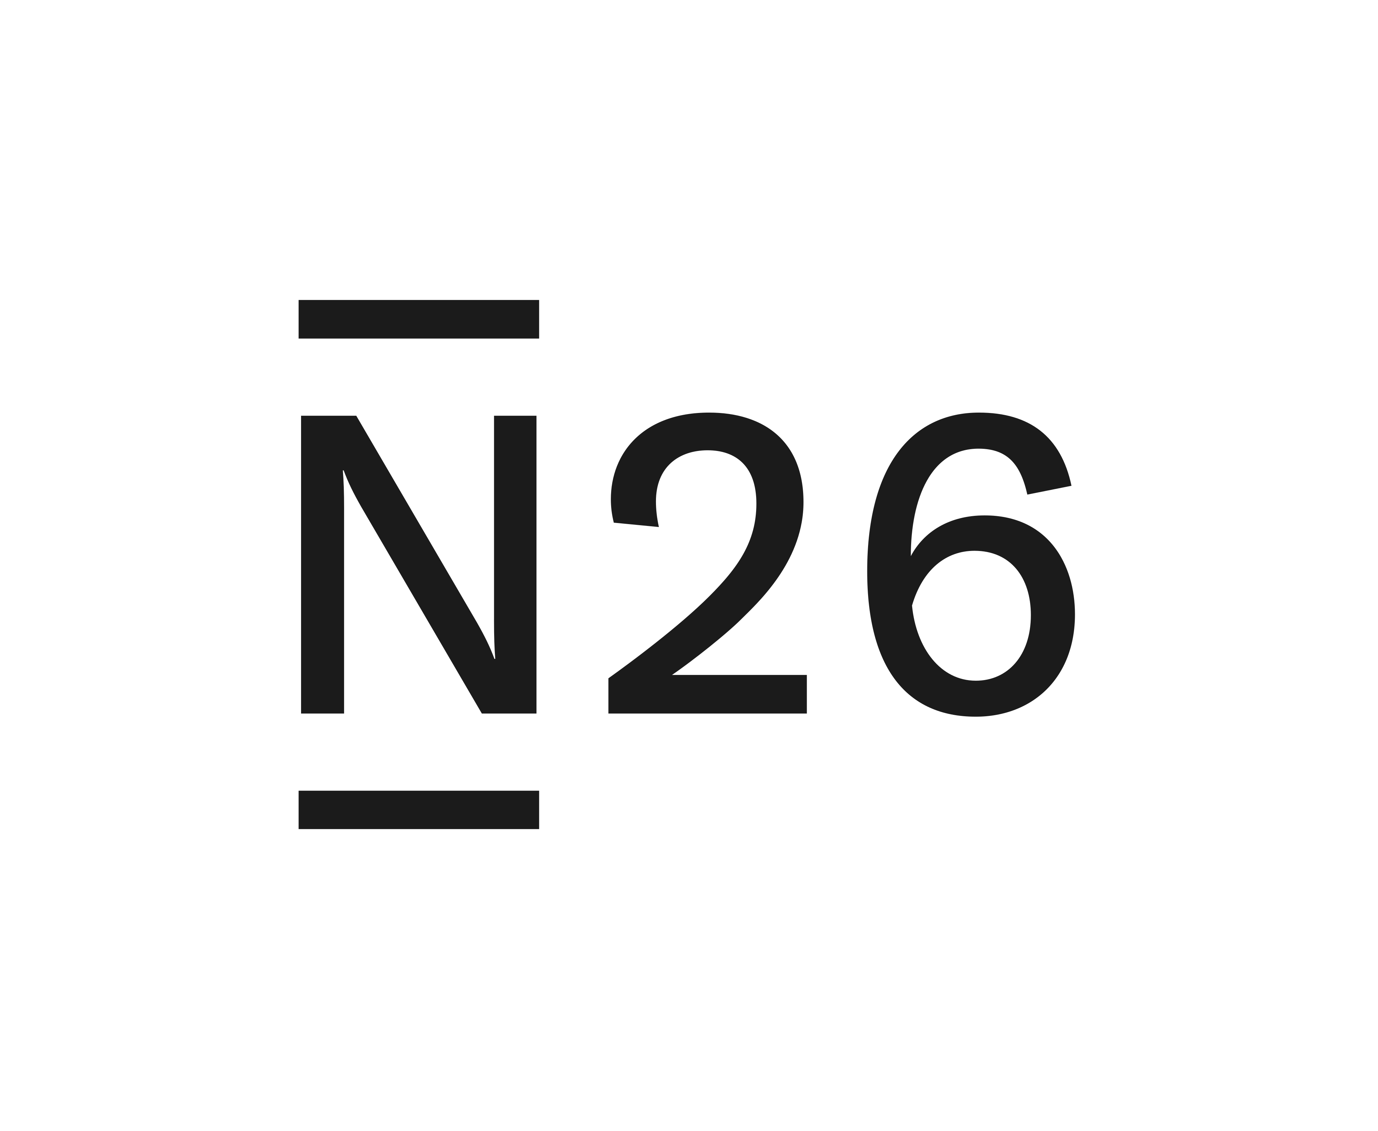













Global and regional banks investing in retail banking plays for salaried customers
We observe three types of moves: game changing, enhance as-is offerings and improve core enablers
x
Detailed next
Anchors of success
Description of success
Best case examples
Game Changers
1
Exclusive Value Prop for Salary Customers
Targeting salary customers with a tailored "digital bank for salary" value proposition and service model that unlocks premium benefits (e.g., subscriptions, cashback, zero-fee transfers) exclusively for payroll customers
2
Affluent customer offerings
Targeting “hidden affluent” customers within the salaried customer base with specialized banking tiers offering customized investment products, preferential terms, and premium experiences to drive loyalty and cross-sell wealth management
Incumbent moves
3
“Stay & Grow" Financial Incentives
Offering dynamic deposit and mortgage/loan rates, based on the percentage of the salary that stays in the account or is spent through the bank's cards over the month
4
On Demand Pay (Earned Wage Access) service
Introducing “On Demand Pay" service for retail clients with an option to access accrued wages ahead of the formal payday for a fee
Enablers
Integrating Ecosystem services (e.g., marketplace) directly into the banking application to maximize customer engagement, screen time, and transactional stickiness for everyday spending
5
B2C ecosystem synergies
6
AI-Driven Customer Engagement Models
Implementing AI-based models for Next-Best-Action, churn prediction, fraud detection, and KYC automation to improve customer engagement and operational efficiency
7
Personalization and Behavioral Incentives
Using personalized and gamification elements (e.g., cashback challenges, interactive stories in-app, financial literacy games) to educate customers, drive product adoption, and increase transaction frequency

Slide 12




Payroll liberalization can be addressed through targeted partnerships with corporates and value proposition upgrade
Main factors influencing switching
Factor
Description
Observed global examples
Key lessons learned
Employer enforcement penalties
Fines or legal consequences for employers who ignore employee bank choice requests
Legal right to switch existed since 2014, yet accelerated adoption started only in 2019 after introduction of fines
  PASHA Bank can directly manage only three factors: employer incentives, employee incentives, and employee awareness
    Employer retention should be protected through deepening existing relationships with corporates
    Employee choice should be influenced with visible salary-linked benefits
    At the same times, these benefits should be clearly marketed to promote staying and even switching from other banks
Frictionless and zero cost switching
Employees can move salary funds instantly and without any associated costs
Introduced open banking API and QRs during rollout
Employer incentives
Employer receives financial or operational benefits that incentivise maintaining a specific salary bank relationship
“Promosyon” (cash bonus tied to salary volumes) paid directly to banks to enforce lock-in
Introduced payroll processing fee waivers and preferential corporate lending rates
Discounted corporate banking fees bundles with payroll contracts
Employee incentives
Employee receives a direct, tangible financial benefit for choosing or staying with a specific bank
Introduced salary-day pre-approved loans and preferential rates
Preferential mortgage rates tied to salary banks
In private sector “promosyon” paid to employees
Consumer awareness
Employees know they have right to switch and under-stand how to exercise it
In 2022, 6 years after reform, 61% of employees never switched salary bank

Slide 13
PASHA can maximize payroll retention by focusing on dual-side value proposition
A
B
Locking corporate customers
Fostering product attachment
Creating incentives from corporate side to retain payroll projects
Influencing individuals to use PASHA salary cards, and cross-sell to the salaried
Key insights
Non-lending features can create functional customer entanglement at minimal cost to the bank
Retail-side monetization will be achieved by cross-selling lending and credit products to the retained salary base
The enhanced retail offering will be cross-subsidized by margins generated from the CIB relationship
Corporate benefit features
Non-lending features
Exclusive partnership with upfront financial incentives for the payroll contract
Operational efficiency (integrated payroll processing)
Simplified vendor management (one bank for corporate + employee banking)
Corporate lending offers for payroll
Preferential treasury pricing (5-15 bps improvement on cash management/credit)
Pre-configured core utility bills (water, electricity, mobile) automatically paid out
Automatic sweep of the incoming salary into labeled "pots“, creating psychological ownership
Early salary access as customer anchor – getting salaries 1-2 days before the official payday
Salary-card specific perks
Lending features
Pre-approved BNPL (Buy Now, Pay Later) limits and other credit lines
Preferential rates or higher approval chance for salaried customers

Slide 14
PASHA Bank’s salary business is highly dependent on a concentrated pool of corporate clients
% total Corporate
Corporate segment accounts holds largest salary base
Within corporate, employees are highly concentrated in separate groups
Key insights
# of employees per segment, ‘000, %
Salary volume¹,
AZN Mn
Groups distribution by employees, ‘000, %
To defend and grow PASHA’s portfolio, payroll project must be treated as a holistic relationship-defense and growth lever
PASHA Bank can prioritize only 10–50 corporate relationships, already securing lock-in of large employee base through tailored account plans, bundled offerings, and targeted employee activation
157
44%
38%
14%
4%
106
4
15
Corporate
67%
149
40
47
SME
20%
33
Commercial
13%
20
Top 10
Next 40
Next 50
Rest
Total
1. Monthly salary, for May 2026

Slide 15
Low product attachment makes payroll customers vulnerable once salary bank choice is liberalized
Affluent customers show higher PASHA attachment
~60K salary customers can be lost in base scenario (no action scenario after liberalization)
Key insights
Distribution of employees based on salary usage habits, ‘000, %
Employee number projections, ‘000
Mass segment is more susceptible to switch banks, as they have lowest product and relationship attachments to banks
Based on other countries experience 30-40% churn can be expected once liberalization is in force
Baseline scenario
High risk of churn
157
152
5
Withdraw
58
33%
Transfer
50%
Use card
99
5%
Keep on card
4%
30%
30%
32%
15%
2026
Potential churn
2029
Mass
Affluent
97%
3%

Slide 16






PASHA can ensure corporate lock-in through strategic business-targeted actions
A
Strategic Action
Description & Enhancements
Market Examples
Sign 3-year exclusive payroll agreements with a lump-sum promotion/bonus (cash incentive) upfront to the company to win their payroll mandate
Garanti BBVA and Akbank use "Maaş Promosyonu" model to fiercely compete for public and private sector payrolls
Exclusive long-term contracts
Offer the company "Payroll Support Loans" to cover short-term payroll needs
Bundles/platforms with comprehensive employee products, insurance and pension plans as a ‘one-stop-shop’
ABB’s Payroll Support credit line covers short-term payroll needs
İşbank often bundles corporate loans with group life and health insurance packages
Bundles & preferential lending
Target the CFOs and CEOs. Offer VIP Private Banking status, waived fees on corporate trade finance, and salary rebates (e.g., 1% cashback to the company on total salaries transferred)
QNB Finansbank offers specialized premium credit cards and high-yield corporate deposits strictly for the executives of their payroll clients
Value prop for decision makers
Offer mandatory automated mass-upload systems and dedicated digital HR portals for seamless onboarding and offboarding of employees
Yapı Kredi offers deep integration with corporate accounting systems, making the operational cost of switching banks high for HR and Finance
ERP & Treasury Integration

Slide 17




Local competitive gap spans every dimension of salary card usage
B
Visa initiative, not currently offered
Feature
Cashback
0.5%-3% cashback, 2x VAT
Up to 30% at partners, 1.5% base
Up to 15% (Fayda Max), 3% utilities
Up to 30% cashback on the default UCard
Neobonuses and PayCard Bonus up to 25% discounts
Key insights
Competing with established mass-market retail banks on standard features will require aggressive retail focus
However, PASHA lending offering is limited due to portfolio and sales restrictions imposed by Pasha Holding
PASHA can limit retail ambitions to a targeted, defensive play focused on retaining corporate payroll and cross-selling to existing base only
Interest on Balance
6% annual on balance >1000 AZN
N/A on standard salary card
N/A on standard salary card
Up to 7% annual
N/A on standard salary card
Ecosystem & Loyalty
Visa discount network
Bir Ecosystem integration
Fayda Max Tiers (Bronze, Silver, Gold, Prime)
UCard Cashback Tiers at partner networks
Discount network
Credit Lines
Lending capped
Up to 30K AZN
Instant "Advance Credit" (up to 1,000 AZN) & preferential cash loans
Eligible to unlock the UCard credit limit (up to 15x salary)
Eligible for consumer loans on preferential terms
Salary advance up to 80%
Grace Period (on unlocked credit products)
Dependent on the specific credit
Up to 63 days
Up to 40 days on the instant "Advance Credit" line
Up to 72 days on UCard credit operations
Dependent on the specific credit
BNPL/Taksit
N/A;
Lending capped
N/A on default salary
Up to 30 months on credit products
'Albalı' credit feature (opt-in) – up to 18 months
N/A on default salary
Corporate commissions
Up to 1.2%.
Free delivery
0.8% standard commission, free card delivery
Standard 0.8%; 10 AZN service fee, free card delivery
Case-by-case rates
0.6% standard commission. Free card issuance

Slide 18


PASHA Bank can further protect its salary customers through revamping its value proposition and increasing lending limits
B
Category
Example of product/service offerings
Essential incentives
  Higher cashback (capped per month), miles, or unique categories that reward card usage
  Free or discounted access to a suite of non-banking services in the ecosystem
  Unlimited free cash withdrawals at the bank's own ATMs or partner network ATMs
  Welcome bonus, such as cash bonus lump sum upon switching to PBA as salary bank
Salary-specific privileges
  Automatic upgrades to higher banking tier segments based on payroll/transaction volume
  Preferential rates on core products like mortgages & deposits, or a higher likelihood of loan approval as more payroll services are used
  Automatically sweeping excess idle salary cash into investment products once a threshold is met
  Saving rate “boosters”, when higher interest rate on savings, activated only in months salary is deposited
  Early Salary Access, when payroll funds are released to the customer 1 to 2 days before the official payday
  BNPL as direct installment options at checkout, allowing employees to split large retail purchases without applying for a separate loan

Slide 19
Within salary customers, affluent can offer stronger revenue upside through higher salary volumes and product penetration
2
Key insights
  Despite representing only 3% of the employees, affluents receive 28% of total monthly salary volumes…
  Both groups have low non-salary product penetration rate with Affluent higher at 9%
  Affluent clients are more receptive and engaged than Mass, and keep higher volumes – primary target for cross-sell
  …and exhibit higher penetration of non-salary products and are more likely to hold lending products
Affluent
Mass
Average monthly salary, AZN
# of other product owners
431
2861
Affluent
5000+
Mass
<5000
% of segment customers
9%
2%
1
156
202
  Affluent customers hold more revenue-generating products – 3 times more likely to have a mortgage and have higher penetration of retail loans
  Higher deposit holdings (10% vs. 3%) also provide crucial funding for the bank's lending activities
3%
Retail loan, %
38%
28%
1
Mortgage, %
33%
11%
2
Deposit holding %
10%
3%
2
Credit card, %
7%
54%
Employees, K
Salary monthly volume, Mn AZN
Insurance, %
16%
6%
1. Only employees who received payments in May 2026; there are 11K total customers holding other products

Slide 20

Regional banks differentiate for affluent through service model and product access
2
Bank
Market
Affluent Proposition
Key Differentiator
Bonus Premium: dedicated RM, priority queuing, premium card, investment advisory
Integration with BBVA global wealth platform
Maximum tier: 0.10pp lower rate on cash loans, bundled insurance, salary advance, priority mortgage
Scale: 1M+ salary customers with automatic tier upgrade
Axess Platinum: multiplied rewards, preferential mortgage (-0.25pp), auto-savings
Digital-first, all services via app
Private Banking for $100K+ AUM; "Halyk Premier" for affluent – RM, investment platform, higher bonuses
Corporate bank defending affluent via relationship
Premier: dedicated RM, investment products, preferential rates, lifestyle perks
60% salary market share - massive cross-sell base

Slide 21












Winning in affluent segment will require differentiated offers and services
2
Component
Example of product/service offerings
Example players
Preferential rates
Preferred rates: 50-75 bps mortgage rate discounts; +100 bps on savings yield, opportunity to offset mortgage interest directly with deposit interest
Preferential rates on international bank transfers
Cards
Differentiated credit and/or debit card: 24x7 Concierge service, international and domestic lounge access, complimentary add-on cards
Loyalty programs
Bank-wide reward points program with customer choice for spending: 2-3x multiplier compared to mass points, 50% bonus on all credit card point earned
Beyond-banking privileges
Premium but standardized perks and privileges to cater to the affluent needs, directly or through partnerships: family travel insurance, access to events, complimentary golf lessons
Products & services
Early upgrade to Private segment (i.e., free benefits), canceled after 6 months if Private conditions are unmet
Access to packaged investment vehicles like Structured Products (Equity-Linked or Currency-Linked Notes) with accessible minimums
Service model
Remote or Virtual RM for ease of access (with 24x7 direct line) and cost-effeciency
Priority phone line or Whatsapp
Channels
Dedicated Affluent app with tailored features and differentiated offering
Improved and digitalized user experience throughout customer journey via different tools

Slide 22
Strategic lever summary – Retail Banking
IMPACT ESTIMATION TO BE VERIFIED WITH BOTTOM-UP MODEL
PASHA Bank vision
Roadblocks
Initiatives
Expected Impact by 2029
Aggressively defending market share against payroll liberalization, targeting salary customers with tailored value prop as a first-choice salary bank and improving acquiring economics while growing the non-lending retail base
Regulations are shifting to enable payroll banking mobility
Defend salary customer base
    Deepen relationships with corporate clients so they proactively encourage their employees to stay with PASHA Bank
    Revamp the core product offering by introducing exclusive, salary-linked incentives
    Revisit lending caps for non-PASHA Holding salary employees to unlock broader cross-selling opportunities
8
  Net banking income impact, AZN MN
Imposed limits on lending to retail restricting growth
Salary proposition lacks attractiveness versus leading retail banking offerings
Capture Affluent Segment Growth
    Tailor existing mass-segment product offerings to create a differentiated, premium experience for affluent customers
PASHA Bank’s retail base is to remain concentrated in the salary segment, with limited diversification opportunities
Integrate advanced analytics or AI-driven customer engagement models
    Implement AI-driven "payday" nudges and Next-Best-Action prompts to guide customer financial decisions
No differentiated offerings for mass-affluent and affluent customers

Slide 24
Backup

Slide 25
Private banking

Slide 26







Most banks define private banking services for customers with assets of USD > 1Mn
1
Emerging affluent & Mass market
<USD100K
Private Banking Tier
Affluent
USD100K-1mn
HNW
USD 1Mn-25Mn
UHNW+
>USD 25Mn
Family office
Global private banking firms
Goldman Sachs Private Banking¹
Morgan Stanley PB²
UBS Private Banking³
Global family office: Min AUM of USD 500Mn
HNW USD2-25Mn
UHWN USD25-500Mn
LGT Private Banking
Global Banks
HSBC
Premier
HSBC
Jade
HSBC Private Banking³
HNW
2-10Mn
UHWN USD10Mn onwards
Min AUM of USD 30Mn
Citi Priority
Citi Gold
Citi Gold Private Client
Citi Private Bank¹
Regional
Banks
CIMB Preferred¹
CIMB Private Banking
DBS Treasures
Treasures Private Client
DBS Private Bank⁴
Min AUM of USD 11-15Mn
SCB Prime
SCB First
SCB Private Banking (Julius Baer)
KBank Premier
KBank The Wisdom
KBank Private Banking
1. Starting from USD10Mn; 2. Starting from USD20Mn; 3. Starting from USD 2Mn; 4. Starting from USD 3.7Mn; 5. Starting from USD 30Mn
Source: Companies websites, expert’s inputs, press search

Slide 27
Retail banking

Slide 28
Existing PASHA Holding limits may block future growth in retail segment
1
PBA is already on track to exceed its lending limits for non-PASHA employees
Current lending limits
Projected lending sales to non-PASHA customers, AZN Mn
Potential actions for PBA
40
Annual lending portfolio allocated to retail segment
  Increase overall lending funding allocated to retail segment, proportionally increasing limit allocated to non-PASHA employees
  Keep funding level the same, but remove cap for non-PASHA employees, allowing teams to allocate funding to high value customers
~21
1
AZN Mn
Estimated based on 2026 Mar-May¹ monthly average sales volumes of ~2 mln AZN
~6 mln
15 mln
15
Annual lending sales limit to non-PASHA Bank and PASHA Holding employees
2
AZN Mn
6,9
-
Annual lending sales limit to PASHA Bank and PASHA Holding employees
2026 5m
2026 projected
1. January and February sales are traditionally low and were excluded from calculation to avoid skewing

Slide 29
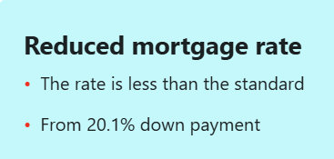

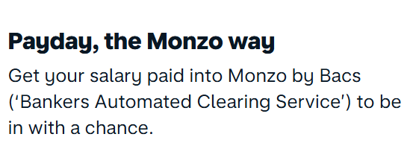
Banking players offer exclusive incentives for their salary customers
1
Banks are driving salary account adoption by offering customers an expanded suite of benefits, including enhanced cashback, preferential conditions, and exclusive perks
Common salary-customer-exclusive benefits
Offered in PASHA Bank as part of Miles&Smiles
Implications
Ecosystem services access with free or discounted access to a suite of non-banking lifestyle services (e.g., insurance, streaming,
e-commerce, mobile data)
  In the context of salary liberalization, establishing a differentiated value proposition is crucial to retain existing clients and capture market share
  Structuring targeted incentives tied to salary spending - such as preferential lending or mortgage rates – will make salary accounts function as an efficient low-cost acquisition engine for PASHA, driving penetration and cross-selling across higher-yield financial products
Reduced fees and waivers on transactional and payment fees
Higher cashback (capped per month), miles or unique categories, rewarding daily card usage
Exclusive promos, e.g., one-off cash bonuses for initiating a salary transfer or targeted campaigns with exclusive retail partners
Preferential conditions such as access, discounted rates, or higher yield for core products (mortgages, auto loans, overdraft facilities), or a higher chance to get a loan approval
Affluent target offering
Tier-based perks with higher banking tier (e.g., Premium) assigned for salary customers when they achieve certain salary thresholds or balances
Source: Bank websites

Slide 30
Unlocking affluent segment is key to expanding funding base
2
Identifying affluent and hidden segment is key for banks to unlock affluent banking
Attracting affluent deposits might be crucial for banks in a stagnating deposit and increasing CoF context
… making their “uncovering” critical for PASHA Bank
Azerbaijan deposits volumes, AZN b
Key identification levers
Banking activity
Salary level & non-salary cash flows
Deposit accumulation
Premium spending patterns
FX transactions & lending tickets
Retail
Corporate
+9%
+1%
Real Estate wealth
Property ownership and valuations
Premium real estate acquisitions
+2%
37.7
38.2
+25%
34.6
33.8
Entrepreneurial activity
Business ownership, revenues and profitability
Multiple business interests
26.9
34%
36%
38%
43%
34%
Investments & assets
Investment portfolio holdings, AUM
Brokerage activity
66%
64%
62%
57%
Lifestyle Indicators
Insured asset values, premium property coverage
Luxury vehicle ownership
Travel and lifestyle patterns
66%
2021
22
23
24
2025
Ecosystem Relationships
Existing relationships within broader PASHA Holding

Slide 31











Banks offer premium customer loyalty programs with a variety of offerings
2
Offers
Examples
Benefit to Bank
Rewards earn and burn platforms – with / without deals on redemption
Points earned for each transaction; spend to get fee waivers
Classic reward redemption
Innovative deals for existing customers to encourage usage of Debit/credit cards
Discounts in stores if credit cards is used
Deepen wallet share / program engagement
Product specific ecosystem with online and offline suppliers
Installment plan for purchase of appliances
Cross sell of core financial services products
Wide range of “Beyond Banking” products offering with wide range of deals
App in app experience
Book movie tickets through the bank app
Increase customer engagement & experience
Own online store with 3rd party vendors with discounts for bank customers
Own marketplace with thousands of sellers and special deals for on-us customers
Open market customer acquisition
Source: Company website, Press search, Expert input

Slide 32

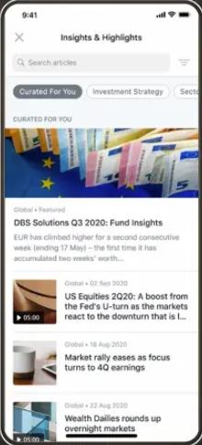
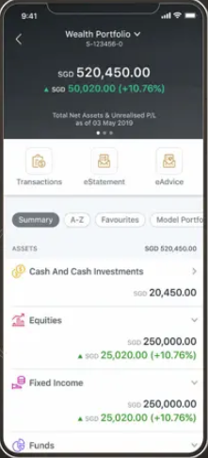
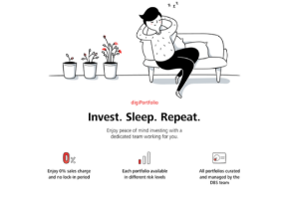
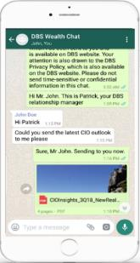
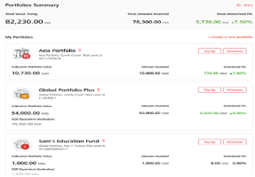
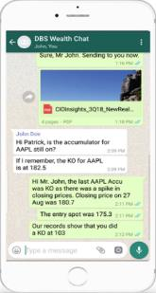
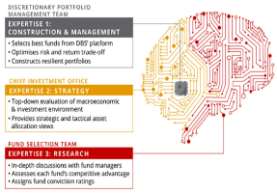
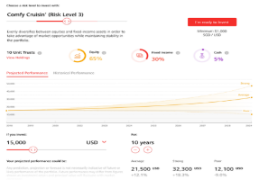
DBS’ iWealth¹ app is amongst the best customer engagement apps that provide customers a differentiated and integrated view on their investment portfolios
2
Illustrative
Wealth education portal
Financial products as “Lifegoals”
Digital transactions
Trusted advisory
Portfolio manager
Home view with updates on global and regional markets with specific insights on client’s current holdings
Current Financial health assessment with savings / investment goal setting tool and life goal product recommendations
Investment tool allowing equity investments across 7 markets in 12 currencies
Robo-advisory with DPM²
24/7 AI Chatbot
Wealth Chat allows instant access to dedicated RM via WhatsApp and WeChat
Integrated portfolio view of all banking, trading and wealth mgmt. portfolios by geography, currency, sector or asset class
iWealth, embedded within Digibank, is an integrated wealth management platform for affluents that allows clients to get the latest view of their portfolio, execute equity trades, fund purchases and more fully online;
Discretionary Portfolio Management
Source: Company website
Notes:
https://enrichneo.com/customer-stories/video-podcast-scaling-wealth-platforms-to-accelerate-digitization-for-banks-post-pandemic

Slide 33











There are several NextGen payment technologies emerging, being built and used by banks, Fintechs, and sophisticated platforms
NextGen technology
Early movers
Description
Considerations
Advanced QR Ecosystems
Establishing proprietary, closed-loop QR payment networks that bypass card scheme fees (Visa/Mastercard) and simplify merchant acquiring
  More complicated journey
  than Apple/Samsung pay
  Requires merchant acquisition
Proprietary
Wallet NFC
Deploying native 'tap-to-pay' capabilities directly within the institution's own mobile application, bypassing third-party OS wallets and card systems
  Requires complex app and POS terminal development
Contactless Payment Stickers
Providing physical NFC-enabled micro-stickers to bypass mobile operating system wallet restrictions and maintain brand visibility on devices
  Involves physical hardware logistics (manufacturing, inventory, distribution)
BioPOS
Eliminating physical payment instruments by utilizing facial recognition and biometric templates to
minimize checkout friction and enhance security
  Significant CAPEX required for terminal upgrades
  Needs strong data protection
Alternative Card Schemes
Leveraging domestic, non-Visa/MasterCard clearing networks to ensure operational resilience, financial sovereignty, and reduced interchange fees
  Dependent on POS upgrades
  Often needs govt support
Real-Time Account-to-Account (A2A)
Bypassing the card network rail to settle funds instantly from the consumer's bank account directly to the merchant
  Direct bank transfers eliminates card swipe fees requiring new monetization

Slide 34
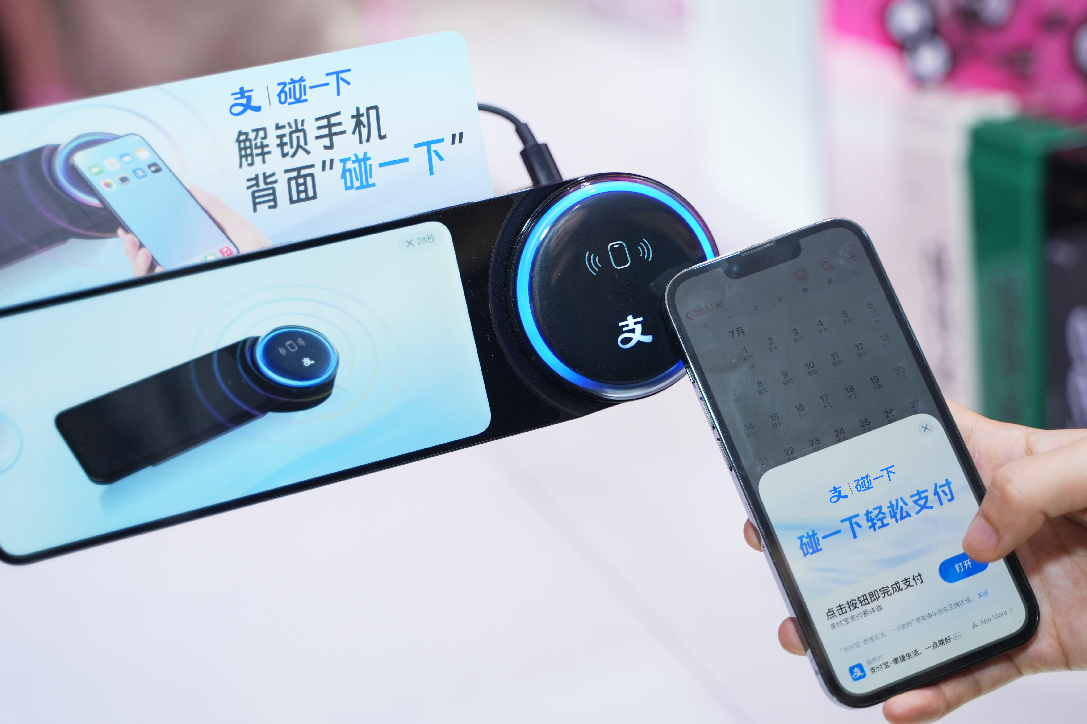
Alipay embeds payments, services, and finance within its wallet service
Summary
Implications
Alipay launched its digital wallet offering which has reached 1.3B active users across the globe
Alipay started as an online payment service provider, before creating its own rails to enable payments while evolving into a comprehensive digital financial ecosystem
Its offering includes:
  Alipay enables users to top up their account with cash, bank transfers, or card enabling the wallet to serve as closed-loop payment ecosystem
  The app can control the transaction process from payment initiation to settlement, without relying on external payment networks, delivering positive unit economics while also driving:
    Contained liquidity within the ecosystem
    Full ownership of transaction data
    High cross-selling conversion
Payments: Alipay allows users to make payments within their Alipay app, web, and / or mobile channels, without charging MDR.
The app mainly leverages QR code and own tap-to-pay capabilities to enable most in-person transactions in China
Life services: Users can access 1,000+ services. Alipay integrates with 3rd party offerings such as Uber, TMall, and Taobao through APIs
Financial services: Users can access financial management products (e.g., wealth management products, lending). Alipay also provides advanced encryption, risk management, and real-time transaction monitoring
Source: Expert interviews, press search, web search

Slide 35
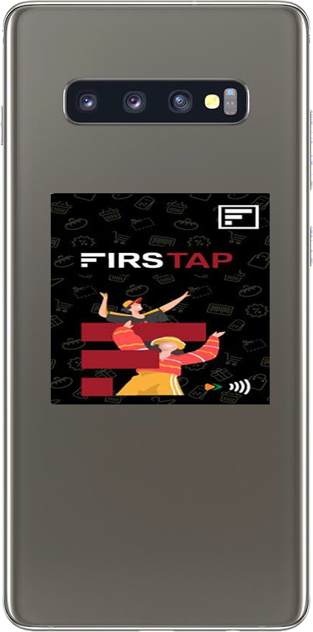
Low-cost stick-on card enables a seamless payment experience for users
A small stick-on card that can be stuck on any frequently carried object, used like an NFC enabled card
How it Works (IDFC
Firstap)
Application and
Payment
Stick on desired
surface
Activate through
App
The user has to apply for the card through IDFC First’s mobile app
The card is delivered to the user. The user can stick the card on any desired device/ surface
The card can be activated through the bank’s app/ INB, after which it is ready to use for tap and pay
Key Players:

